Slide 1







RideEase
“Seamless Journey Every Time"

Slide 2



AGENDA
❖BRM Diagram
❖Context Diagram
❖RoadMap
❖RCT (main view only)
❖User Stories
❖UML Activity Diagram
❖ER Diagrams
❖Burndown Charts
❖Jenkins Progress Report
❖Live [Recorded] Application Demo

Slide 3
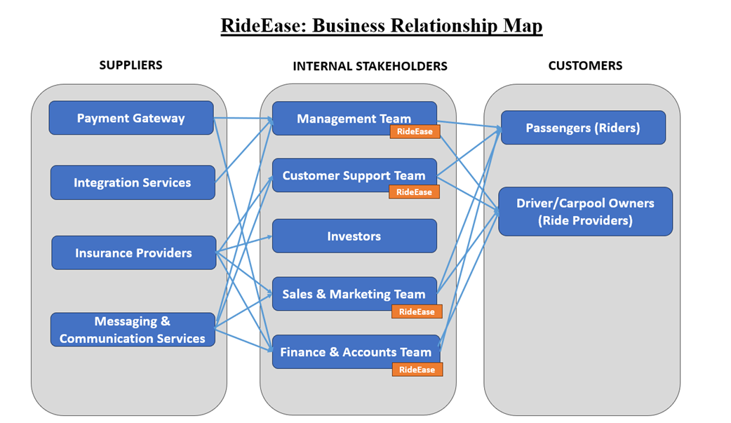


BRM Diagram
Manjusha Domala

Slide 4
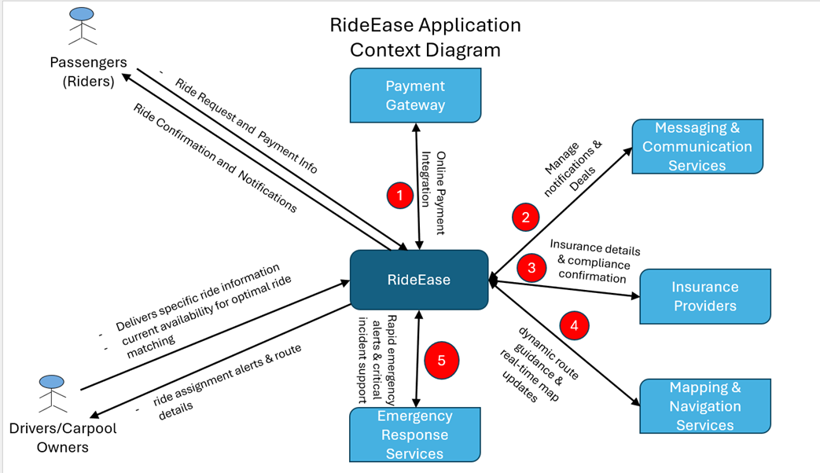


CONTEXT DIAGRAM
Manas Karande

Slide 5
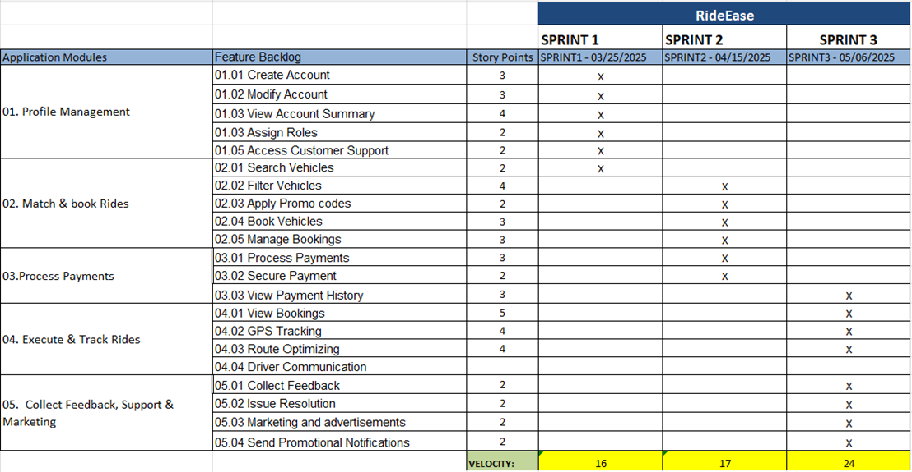

ROAD MAP
Shivani Jain

Slide 6
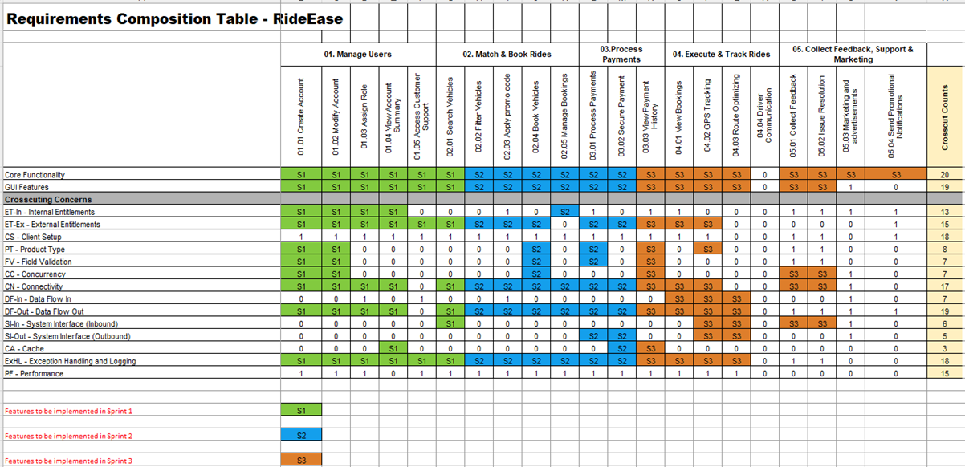
RCT: Main view only
Karan Yadav

Slide 7
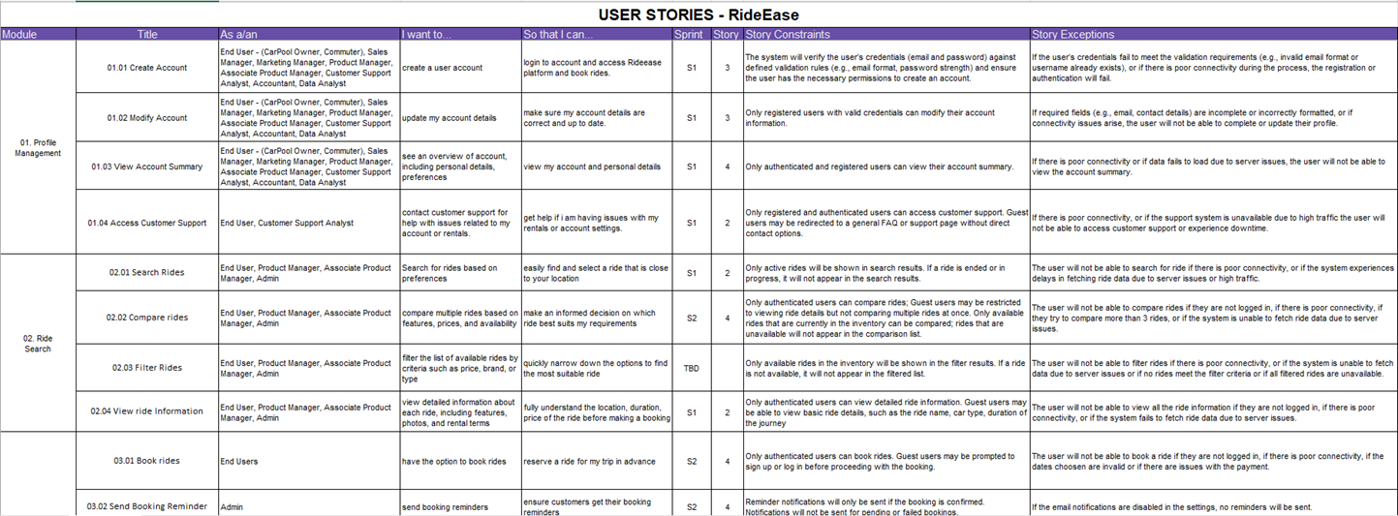
USER STORIES
Abhay Soni

Slide 8
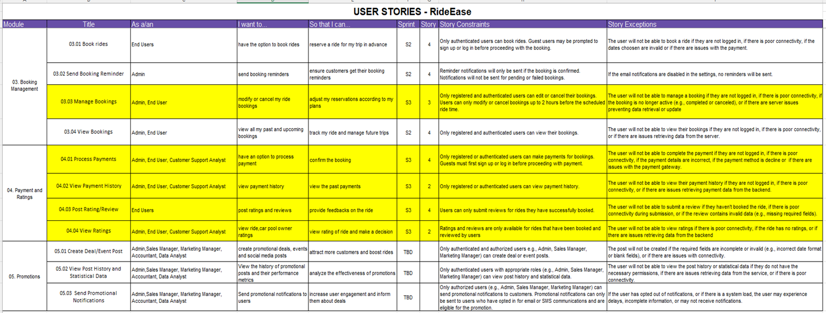
USER STORIES
Abhay Soni

Slide 9
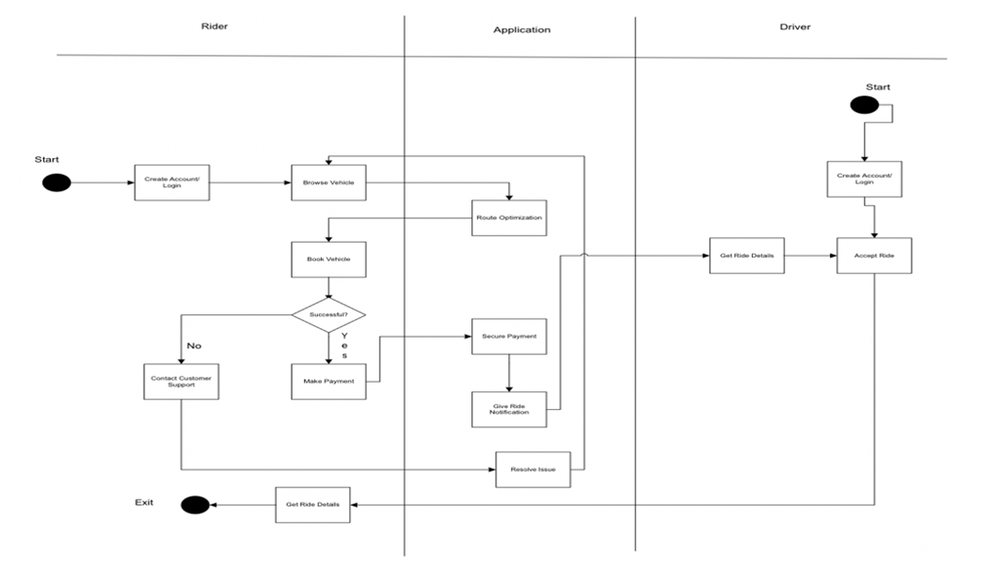
UML ACtivity diagram
abhyaung havale

Slide 10
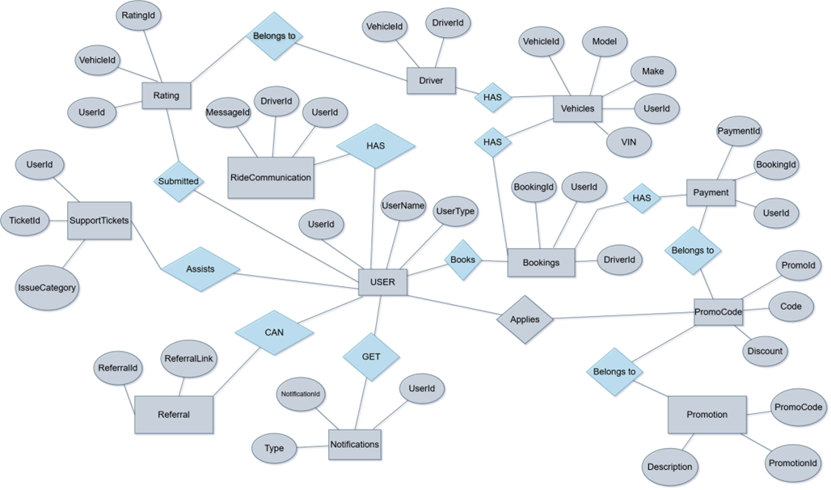
ER DIAGRAM - Conceptual
(Shivam Dubey)

Slide 11
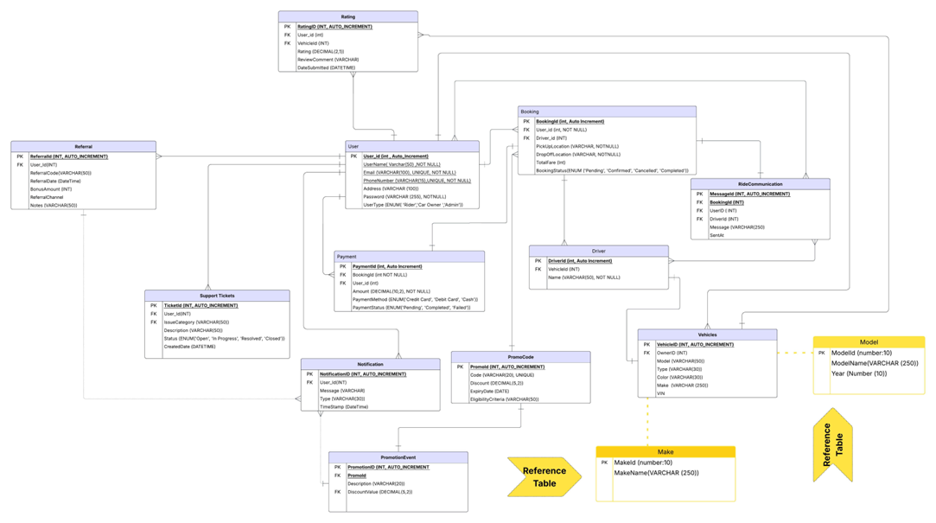
ER DIAGRAM – Logical
(Shivam Dubey)

Slide 12
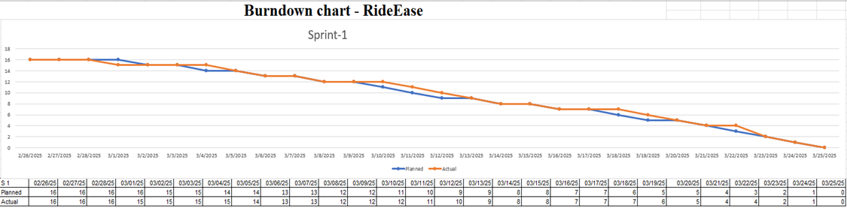
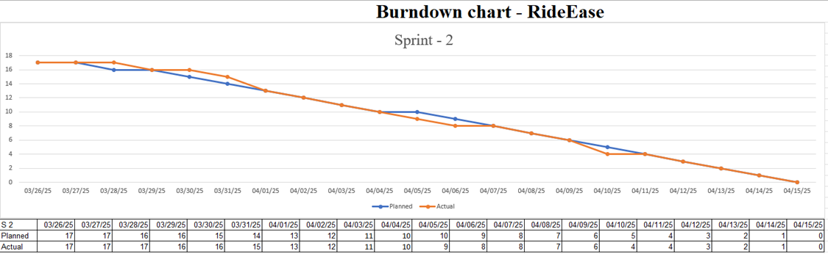
BURNDOWN CHARTS
Abhishek Kasula
Sprint 1
Sprint 2

Slide 13
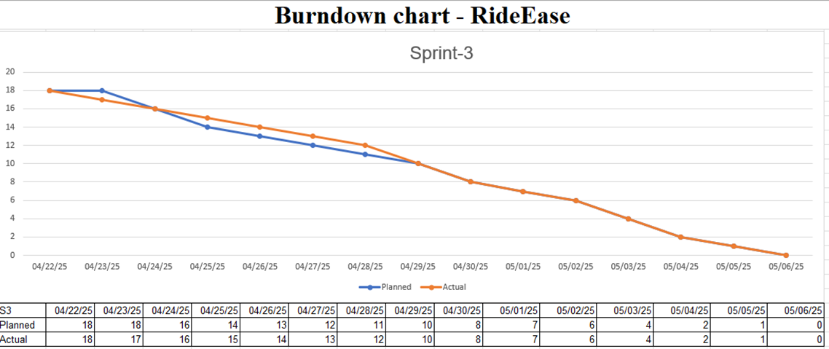
BURNDOWN CHARTS
Abhishek Kasula
Sprint 3

Slide 14
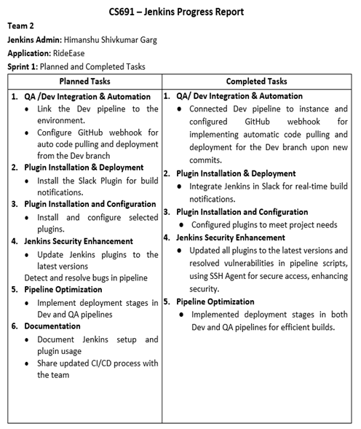
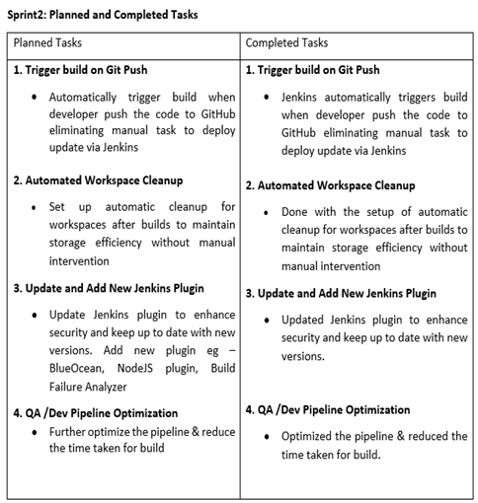
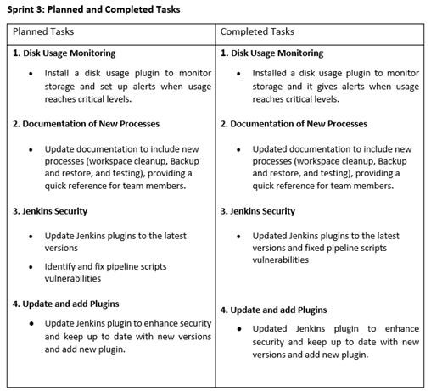
JENKINS PROGRESS REPORT
Himanshu Garg

Slide 15
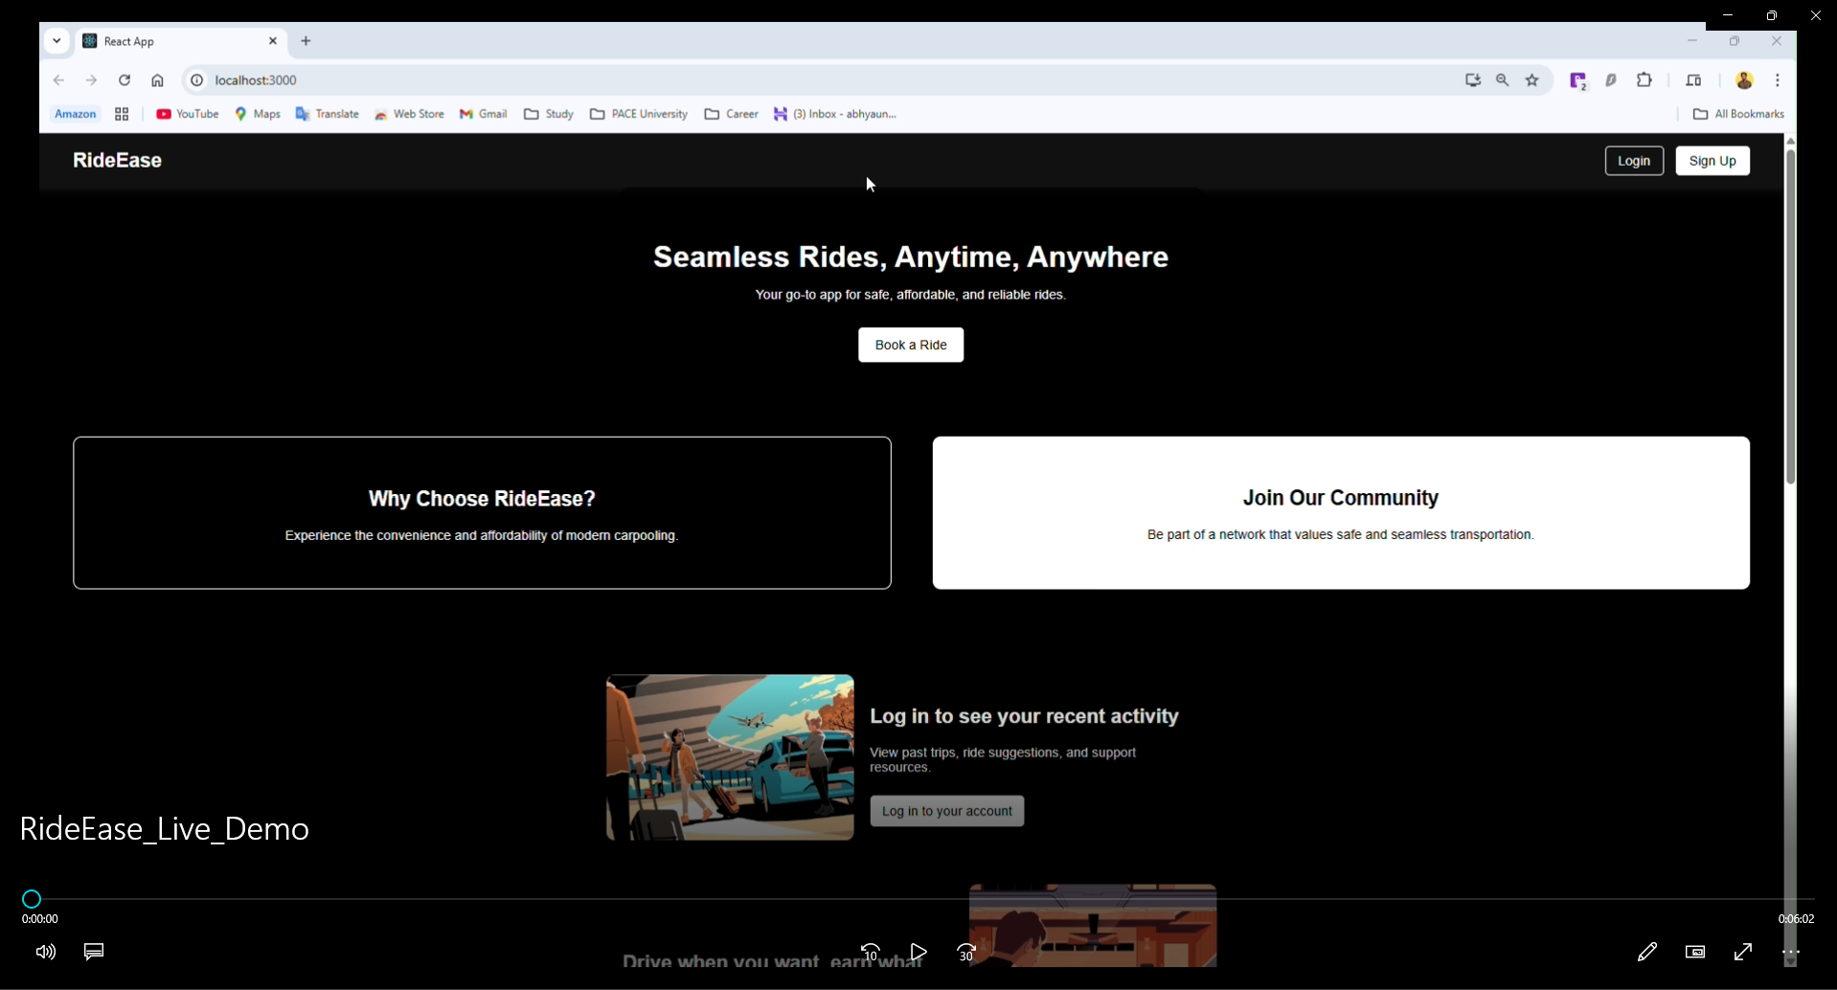
Live Demo
Abhyaung Havale & Anish Ayare

Slide 16

Thank You

